Slide 1


Benjamin Leppard
6/7/25

Slide 2

Outline
Executive Summary
Introduction
Methodology
Results
Conclusion
Appendix

Slide 3
Executive Summary
Existing SpaceX data was used to build models that aimed to predict whether first-stage boosters would land successfully. The data was first processed, and exploratory data analysis was used to determine which features might be of importance. The data was split into training and testing datasets to assess how well the model performed with unseen data. Logistic Regression(LR), Support Vector Machine(SVM), and K-Nearest-Neighbors(KNN) models were trained and tuned using GridSearchCV to determine the optimal parameters.
It was found that LR, SVM, and KNN models all performed equally well on the testing data at predicting successful landings, with 83.3% accuracy. A decision tree model most closely fits the training data at 89.1% accuracy. However, it performed poorly on the testing data, with an accuracy of 72.2%.

Slide 4
Introduction
SpaceX is currently the most successful company involved in space travel. Their success is due in part to their relatively inexpensive launch costs, as compared to their competition. A major reason for these lower prices is the ability to successfully land first-stage boosters and reuse them.
To predict the price of a launch, we must predict whether the first booster will land successfully. Using existing data, we can determine how factors such as payload mass, launch site, and orbit affect landing success. We will also determine the best algorithm for predicting landing success.

Slide 5

Section 1

Slide 6
Methodology
Data collection methodology:
SpaceX REST API
Web scraping of Wikipedia pages
Perform data wrangling:
Filtering data
Dealing with missing values
Using one-hot encoding for binary classification
Perform exploratory data analysis (EDA) using visualization and SQL
Perform interactive visual analytics using Folium and Plotly Dash
Perform predictive analysis using classification models
Logarithmic Regression, Decision Tree, SVM, and KNN models were trained and tuned using GridSearchCV and then evaluated using unseen data.

Slide 7
Data Collection
Data was first collected using the SpaceX REST API, specifically the “/launches/past” endpoint. (api.spacexdata.com/v4/launches/past)
Columns collected:
Data was also collected by web scraping the Wikipedia page titled “List of Falcon 9 Heavy Launches.” (https://en.Wikipedia.org/wiki/List_of_Falcon _9_and_Falcon_Heavy_launches)
Columns collected:
Flight Number, Date, Booster Version, Payload Mass, Orbit, Launch Sites, Outcome, Flights, Grid Fins, Reused, Legs, Landing Pad, Block, Reused Count, Serial, Longitude, Latitude
Flight Number, Launch Site, Payload, Payload Mass, Orbit, Customer, Launch Outcome, Version Booster, Booster Landing, Date, Time

Slide 8
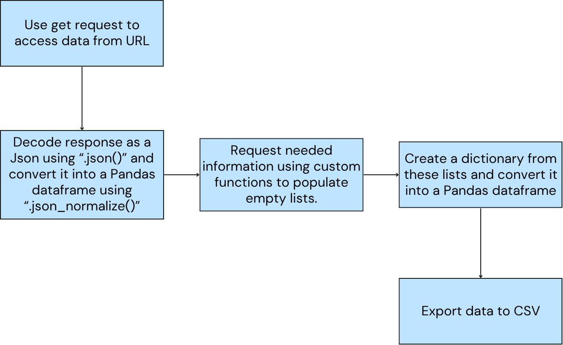
Data Collection – SpaceX API
Place your flowchart of SpaceX API calls here
https://github.com/leppardben/Capstone_Project/blob/main/1_Data_Collection_API.ipynb

Slide 9
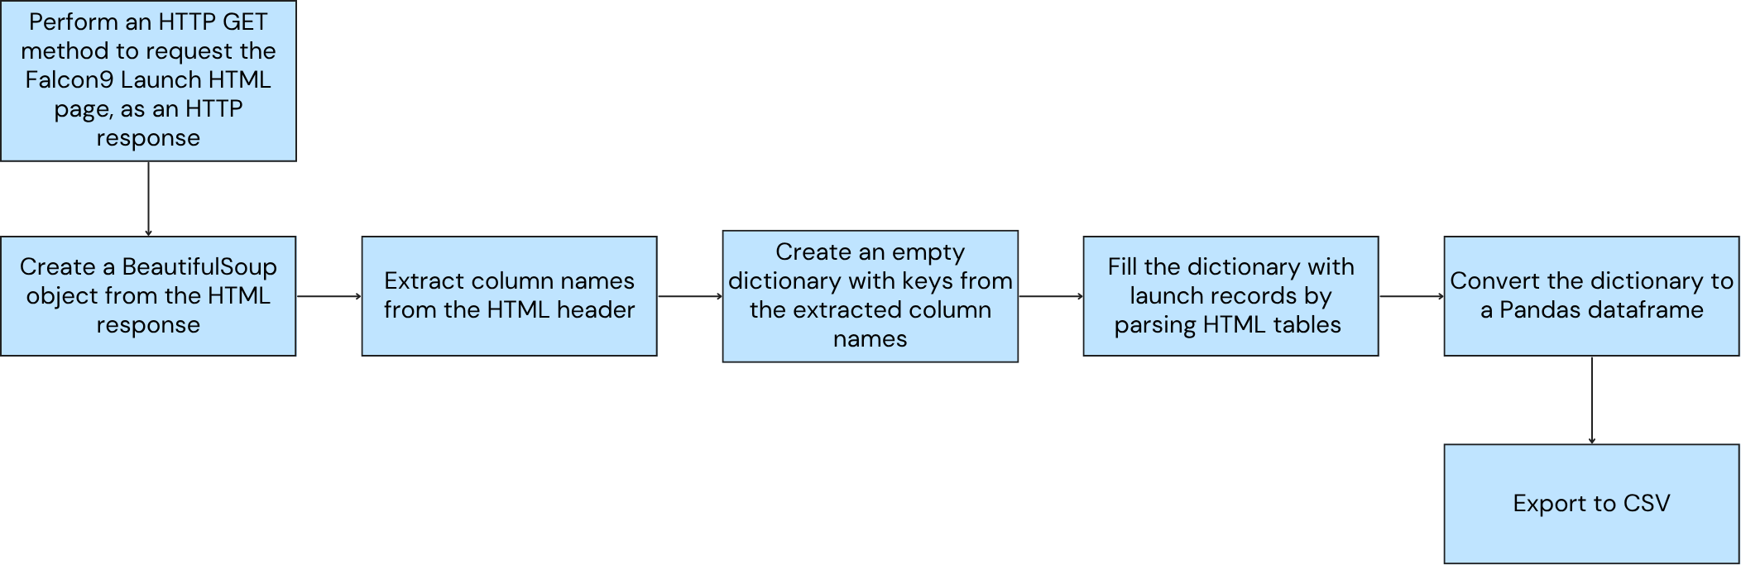
Data Collection - Scraping
https://github.com/leppardben/Capstone_Project/blob/main/2_Data_Collection_Webscraping.ipynb

Slide 10
Data Wrangling
Data was filtered to only include the following features of interest:
‘rocket', 'payloads', 'launchpad', 'cores', 'flight_number', 'date_utc’
Rows with multiple cores and multiple payloads were removed, as well as all rows that included Falcon 1 launches.
Rows where the landing outcome is missing were removed.
Missing values for Payload Mass were replaced with the mean Payload Mass.
Assigned numeric values to each Landing Outcome and mapped those values to 0 for unsuccessful outcomes and 1 for successful landings.
https://github.com/leppardben/Capstone_Project/blob/main/3_Data_Wrangling.ipynb

Slide 11
EDA with Data Visualization
Data visualization was used to better understand the relationship between variables and investigate trends.
Charts/plots used:
Flight Number vs Payload Mass
Flight Number vs Launch Site
Payload Mass vs Launch Site
Orbit Type vs Landing Outcome
Flight Number vs Orbit Type
Payload Mass vs Orbit Type
https://github.com/leppardben/Capstone_Project/blob/main/5_EDA_Viz.ipynb

Slide 12
EDA with SQL
Performed SQL queries:
Displaying the names of the unique launch sites in the space mission
Displaying 5 records where launch sites begin with the string ‘CCA’
Displaying the total payload mass carried by boosters launched by NASA (CRS)
Displaying average payload mass carried by booster version F9 v1.1, listing the date when the first successful landing outcome in ground pad was achieved
Listing the names of the boosters that have been successful on drone ships and have a payload mass greater than 4000 but less than 6000
Listing the total number of successful and failed mission outcomes
Listing the names of the booster versions that have carried the maximum payload mass
Listing the failed landing outcomes in drone ship, their booster versions, and launch site names for the months in the year 2015
Ranking the count of landing outcomes (such as Failure (drone ship) or Success (ground pad)) between the dates 6/4/2010 and 3/20/2017 in descending order
https://github.com/leppardben/Capstone_Project/blob/main/4_EDA_SQL.ipynb

Slide 13
Build an Interactive Map with Folium
Launch Site Markers:
Added Markers with Circles, Popup Labels, and Text Labels to NASA Johnson Space Center using its latitude and longitude coordinates as a start location.
Added Markers with Circles, Popup Labels, and Text Labels to all Launch Sites using their latitude and longitude coordinates.
Colored Markers displaying launch outcomes at each Launch Site:
Added colored Markers of success (Green) and failed (Red) launches using Marker Cluster to identify which launch sites have relatively high success rates.
Distance between a Launch Site and its proximities:
Added colored Lines to show distances between the Launch Sites and their proximities like railways, highways, and Coastlines.
https://github.com/leppardben/Capstone_Project/blob/main/6_Folium_map.ipynb

Slide 14
Build a Dashboard with Plotly Dash
Added a dropdown list to enable Launch Site selection.
Pie chart displaying total successful launches by site.
Scatter chart of Payload Mass vs. Success Rate for each Booster Version with a slider to select Payload Mass range.
https://github.com/leppardben/Capstone_Project/blob/main/7_spacex_dash_app.py

Slide 15
Predictive Analysis (Classification)
Built machine learning models using the following steps:
Created a Numpy array from the column “Class”
Standardized data using the StandardScaler and fit_transform functions
Split the data into training and testing sets using the test_train_split function
Use GridSearchCV to create models using the following algorithms:
Logistic Regression
Support Vector Machine (SVM)
Decision Tree
K Nearest Neighbors (KNN)
Fit models to the training dataset
Find the best hyperparameters for each model
Evaluate models using the testing dataset, based on the accuracy scores and confusion matrices
https://github.com/leppardben/Capstone_Project/blob/main/8_Predictive_Analysis.ipynb

Slide 16
Results
Exploratory data analysis results
Interactive analytics demo in screenshots
Predictive analysis results

Slide 17

Section 2

Slide 18
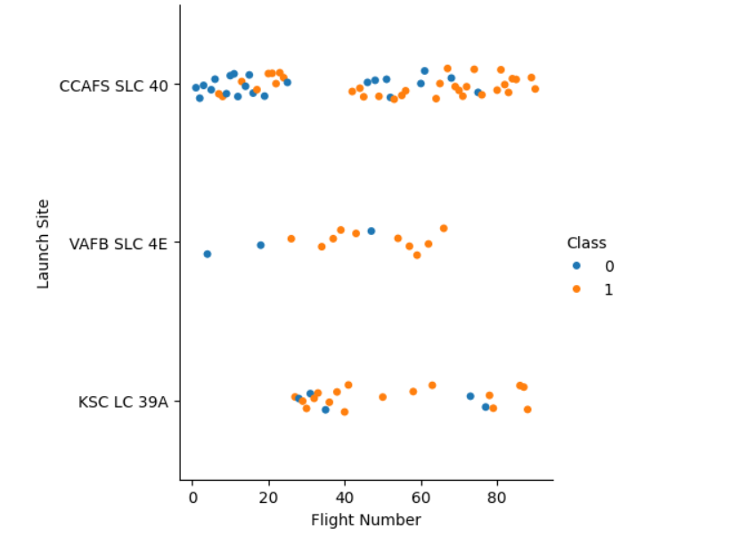
Flight Number vs. Launch Site
For all launch sites, the first stage is more likely to land successfully as Flight Number increases.
CCAFS SLC 40 is the most frequent launch site and has the worst success rate.

Slide 19
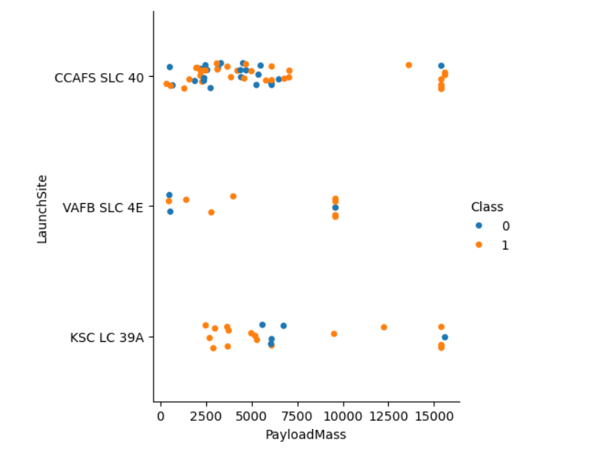
Payload vs. Launch Site
For “CCAFS SLC 40”, the success rate significantly increases for heavy payloads.
“KSC LC 39A” saw its highest success rate for payloads below 5000kg and above 7500kg

Slide 20
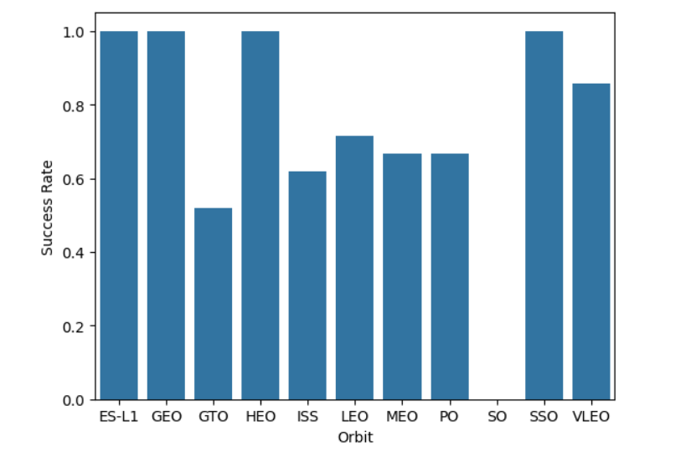
Success Rate vs. Orbit Type
Orbit types: “ES-L1”, “GEO”, “HEO”, and “SSO” all have a 100% success rate.
The orbit type “SO” has yet to record a successful landing.

Slide 21
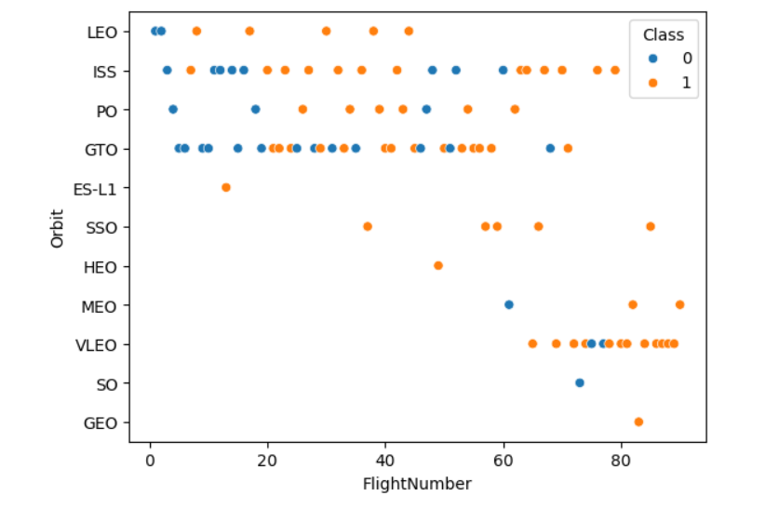
Flight Number vs. Orbit Type
For all orbit types, the success rate tends to go up with flight number.

Slide 22
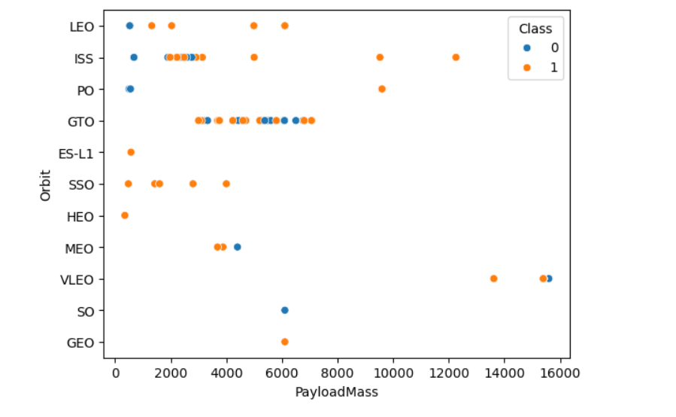
Payload vs. Orbit Type
For orbit types: LEO, ISS, and PO, the unsuccessful landings tended to occur with small payloads.

Slide 23
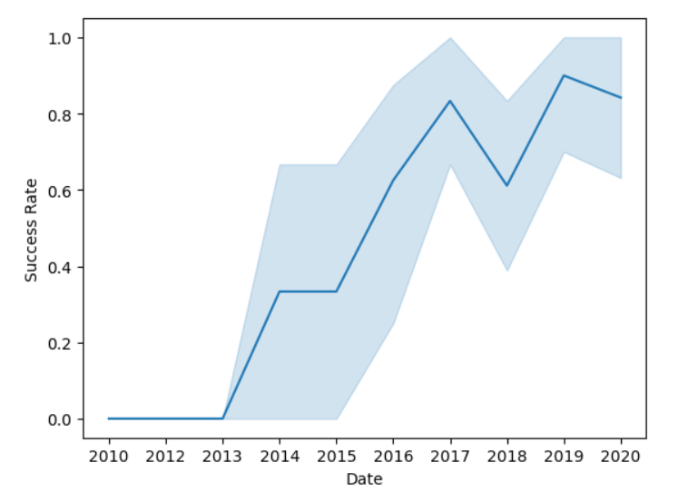
Launch Success Yearly Trend
Overall, the success rate increases over time, starting in 2013 with the first successful landing.
After 2017, this upward trend seems to level out, with some ups and downs.

Slide 24
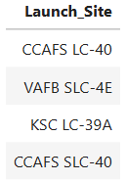
All Launch Site Names
Query result displaying the names of all launch sites.

Slide 25
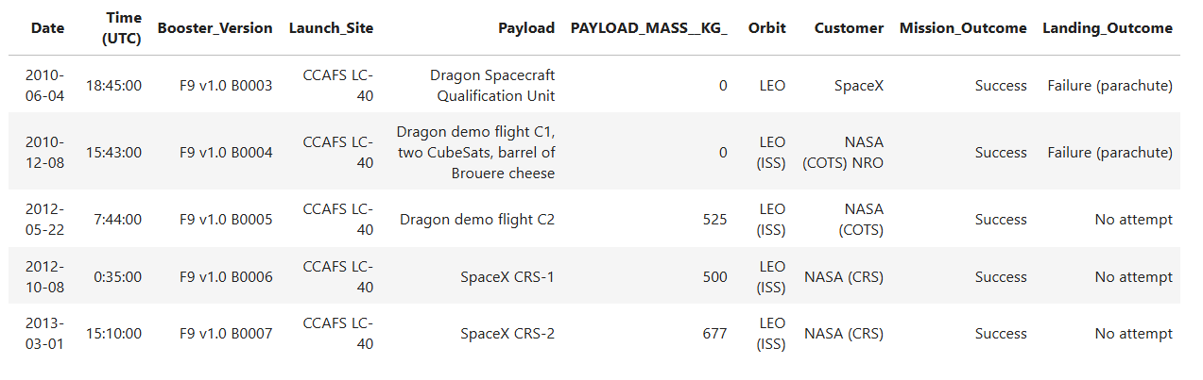
Launch Site Names Begin with 'CCA'
Query results showing records for launch sites beginning with ‘CCA’.

Slide 26
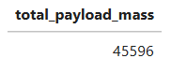
Total Payload Mass
Query result showing the total payload mass carried by NASA boosters.

Slide 27
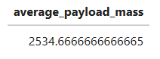
Average Payload Mass by F9 v1.1
Query result showing the average payload mass carried by booster version F9 v1.1

Slide 28
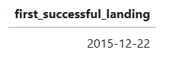
First Successful Ground Landing Date
Query results showing the date of the first successful landing outcome on a ground pad.

Slide 29
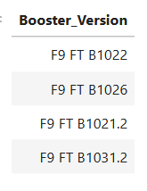
Successful Drone Ship Landing with Payload between 4000 and 6000
Query result showing the names of boosters which have successfully landed on drone ship and had payload mass greater than 4000 but less than 6000

Slide 30
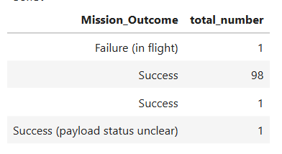
Total Number of Successful and Failure Mission Outcomes
Query result showing the total number of successful and failed mission outcomes.

Slide 31
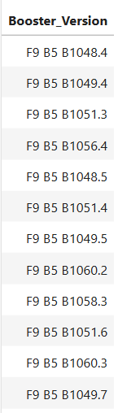
Boosters Carried Maximum Payload
Query result showing the names of the boosters that have carried the maximum payload mass

Slide 32
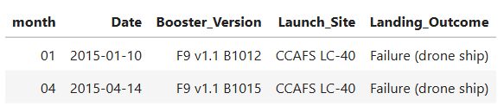
2015 Launch Records
Query result showing the failed landing outcomes on drone ships, their booster versions, and launch site names for the year 2015

Slide 33
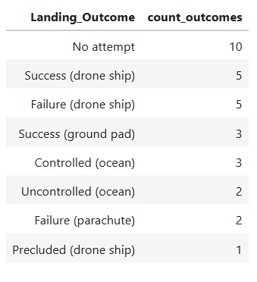
Rank Landing Outcomes Between 6/4/2010 and 3/20/2017
Query result displaying the counts of landing outcomes between the dates 6/4/2010 and 3/20/2017, in descending order.

Slide 34

Section 3

Slide 35
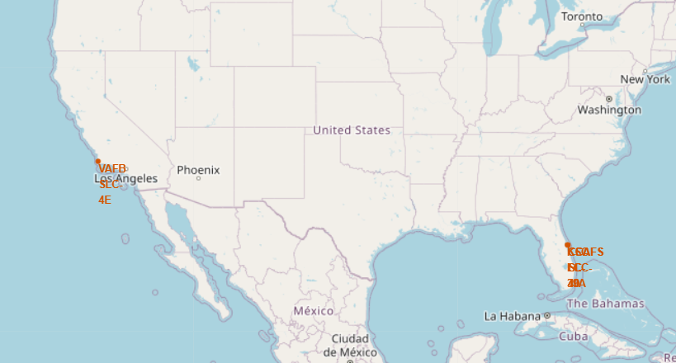
Folium Map Showing All Launch Sites
All launch sites are located towards the equator.
Launch sites are also located in close proximity to the coastline

Slide 36
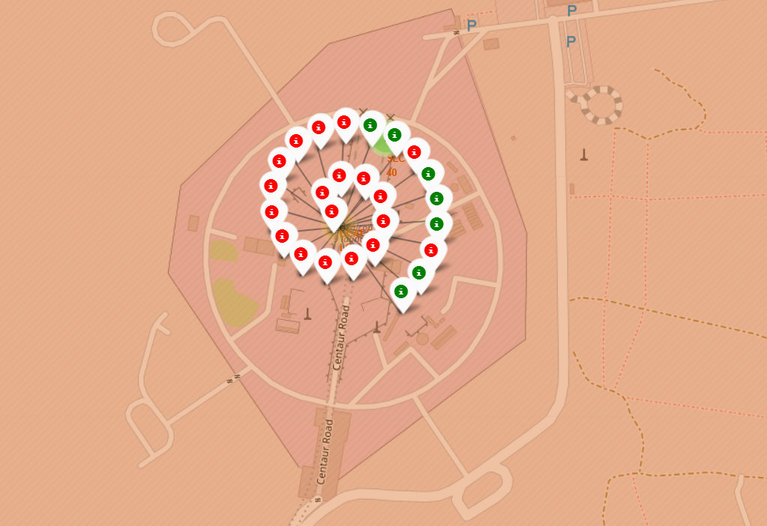
Folium Map Showing Launch Site Success Rate
Green dots represent a successful landing
Red dots represent failed landings

Slide 37
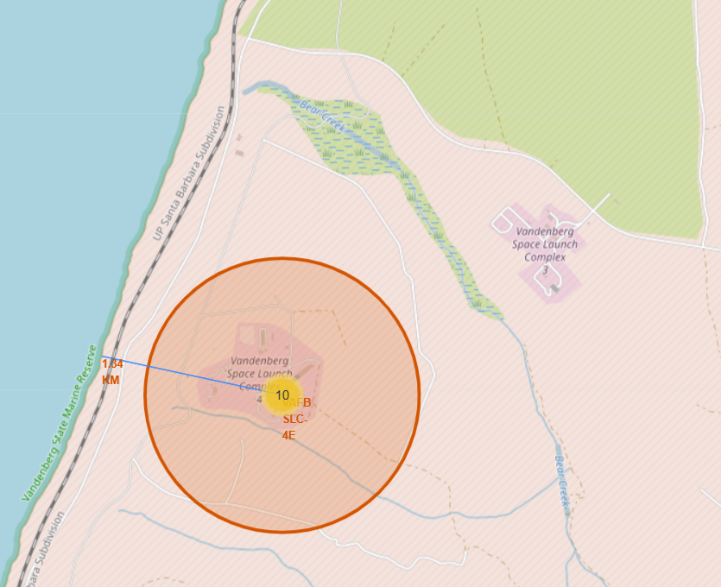
Folium Map Showing Distance from Launch Site to Coastline
The distance line highlights the proximity to the coastline (1.54 km)

Slide 38

Section 4

Slide 39
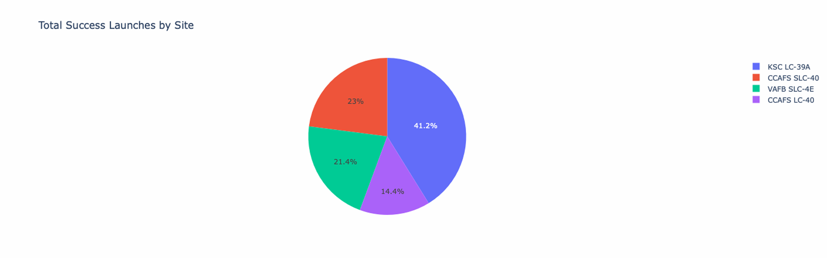
Total Successful Landings by Site
Site “KSC LC-39A” has the most successful landings

Slide 40
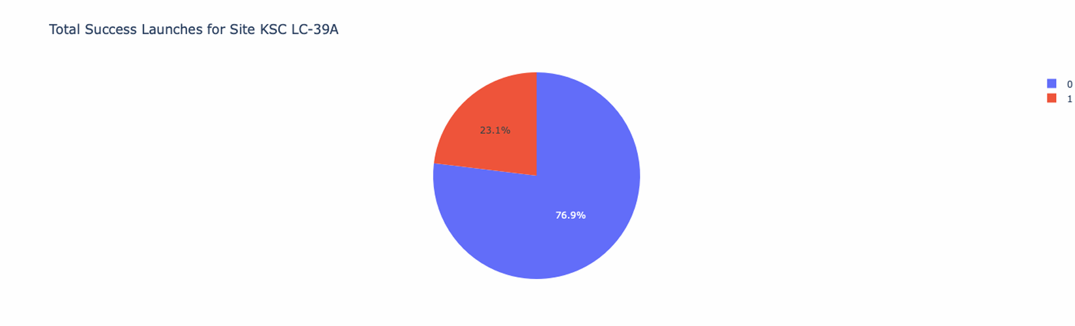
Landing Success Rate for “KSC LC-39A”
Site “KSC LC-39A” has a success rate of 76.9%

Slide 41

Section 5

Slide 42
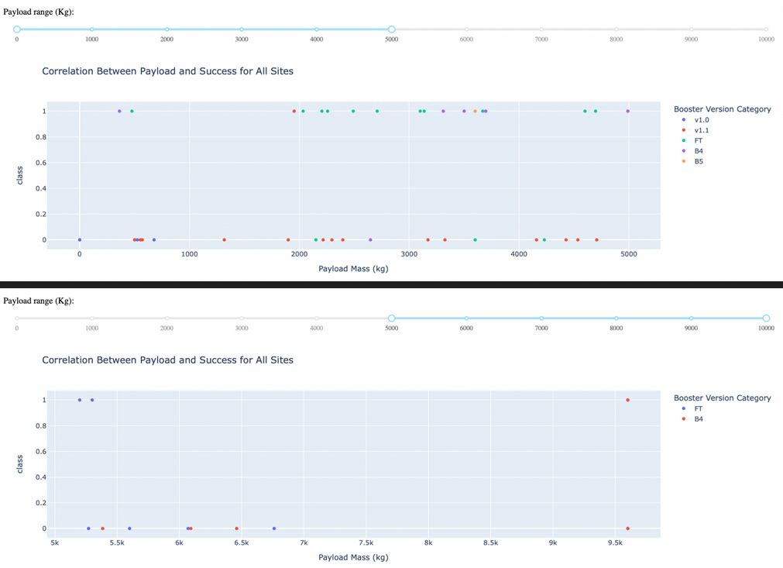
Payload Mass vs Landing Success
Higher payloads resulted in a higher rate of success

Slide 43
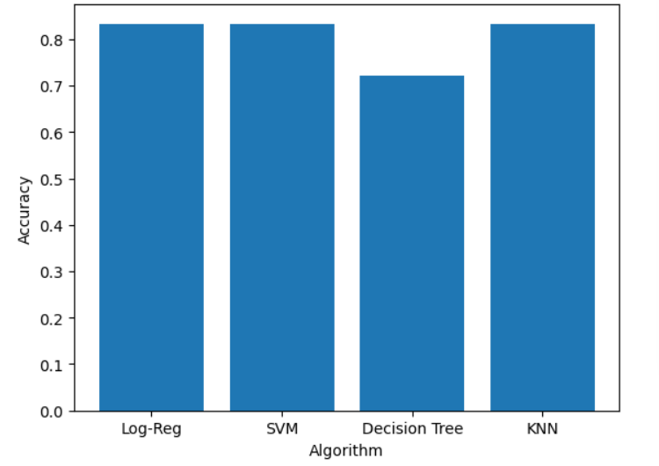
Classification Accuracy
Logistic Regression, SVM, KNN models all displayed approximately the same accuracy in predicting test data.

Slide 44
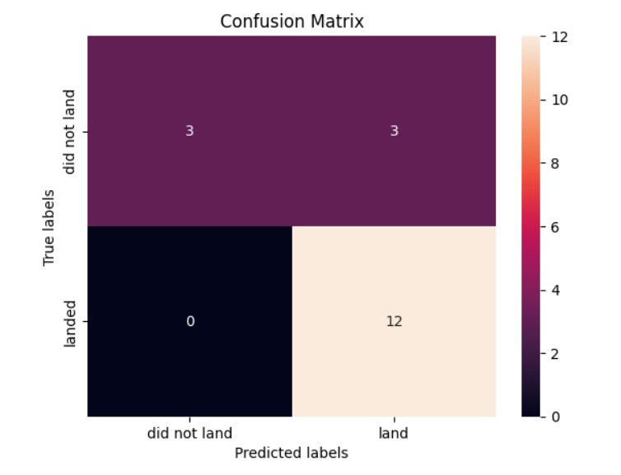
Confusion Matrix
The confusion matrix shows that the mislabeled classes were false positives.

Slide 45
Conclusions
The data can be most effectively modeled using KNN, SVM, or Logistic Regression
Landing success rates have increased over time
Payload mass has a positive correlation with landing success.
KSC LC-39A has the highest success rate of all launch sites.
Most launch sites are located near the equator and are in close proximity to the coast.
Orbits ES-L1, GEO, HEO, and SSO have a100% success rate.

Slide 46


